Slide 1
Service Line Detection
of busses using Hidden Markov Models
Sven Milker

Slide 2
Agenda
Introduction
Hidden Markov Models
Viterbi
Modeling
Implementation
Evaluation
Conclusion
Future Works

Slide 3
Introduction
What does „Service Line Detection“ mean?

Slide 4
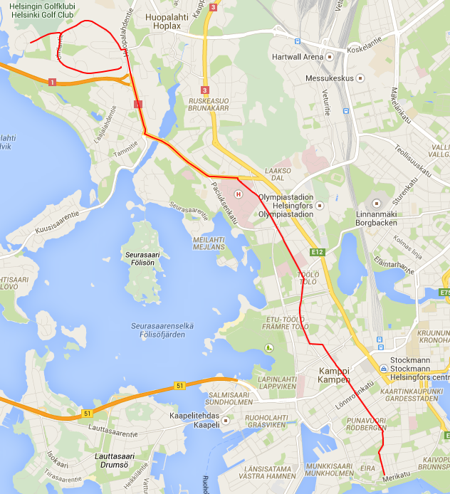

Slide 5
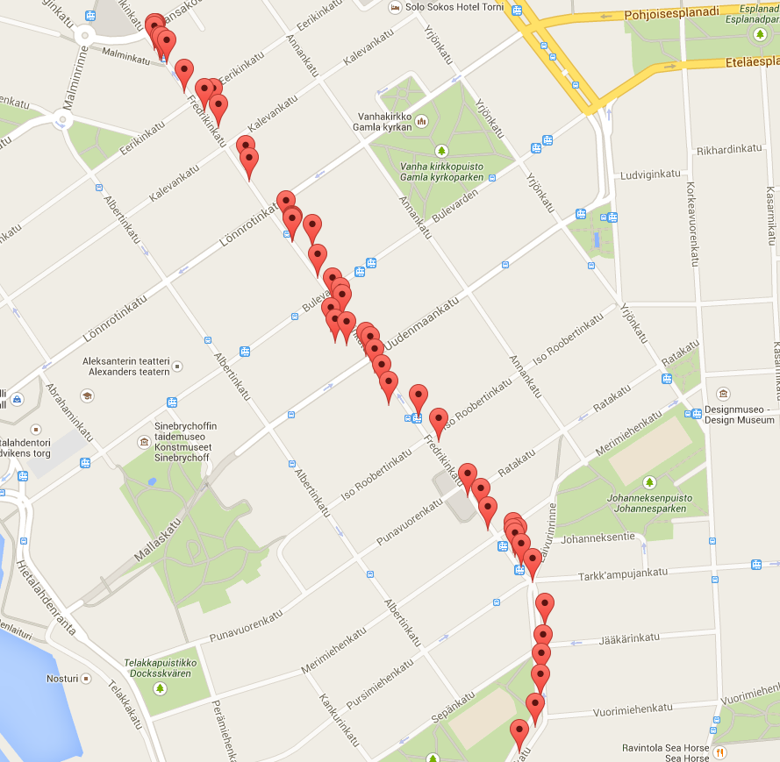

Slide 6
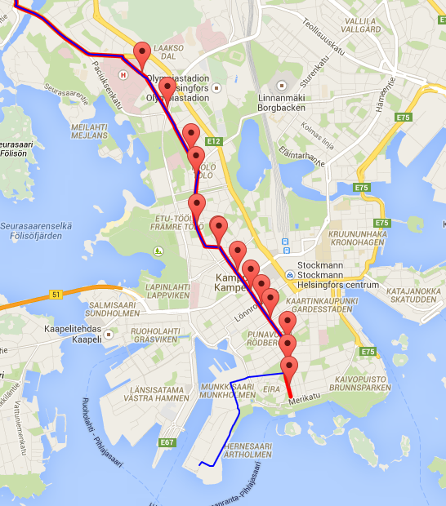

Slide 7
Introduction
What does „Service Line Detection“ mean?
What did others do?
Predicting Bus Arrival Time (Zhou, Zheng & Li, 2014)
Transportation Mode Detection
Shah, Wan, Lu & Nachman (2014)
Stenneth, Wolfson, Yu & Xu (2011)
Live+Gov
What is our approach?

Slide 8
Hidden Markov Models
Stochastical Model
Elements
States
Rabiner (1989)

Slide 9
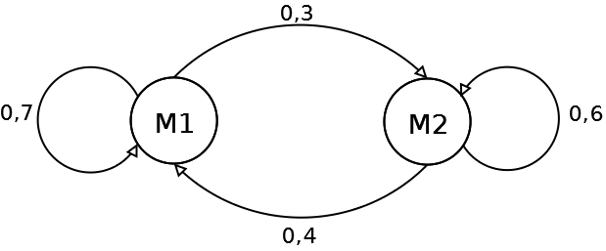
Hidden Markov Models

Slide 10
Hidden Markov Models
Stochastical Model
Elements
States
Observations

Slide 11
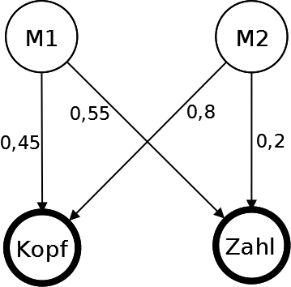

Slide 12

Hidden Markov Models
Stochastical Model
Several Elements
States
Observations
Probabilites
State transition probability: $a\text{ij}$
Observation probability: $b_{j}\left(\text{O}\right)$
Initial state probability: π_{i}

Slide 13
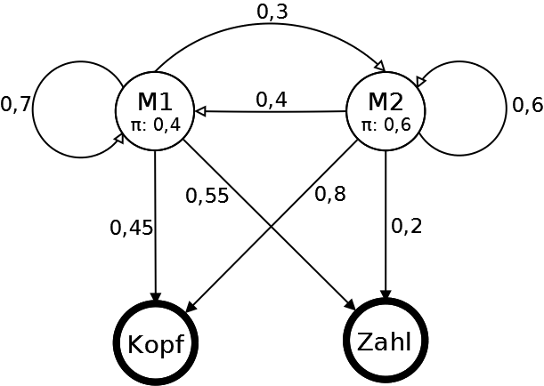

Slide 14
What can we do with it?
Compute probability of an observation sequence
Compute corresponding state sequence

Slide 15
Viterbi
Clever way to compute state sequence
Uses intermediate data
Recursively computes state sequence probabilities
Gets state sequence through backtracking

Slide 16
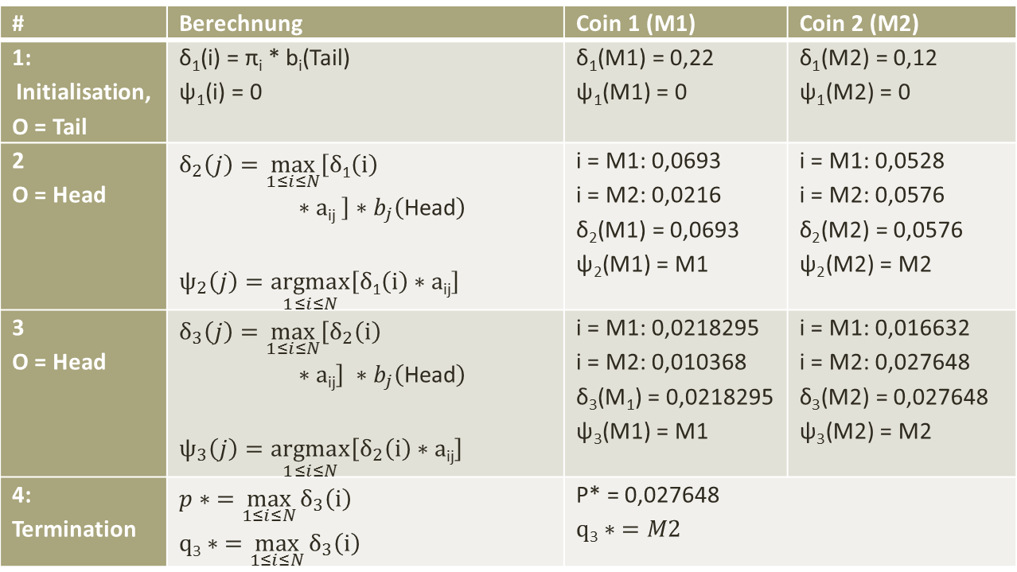
Viterbi example
# | Berechnung | Coin 1 (M1) | Coin 2 (M2)
1: Initialisation, O = Tail | δ₁(i) = π_{i} * b_{i}(Tail) ψ₁(i) = 0 | δ₁(M1) = 0,22 ψ₁(M1) = 0 | δ₁(M2) = 0,12 ψ₁(M2) = 0
2 O = Head | $$δ_{2}\left(j\right)=\max_{1≤i≤N}\left[δ\text{1}\left(i\right)∗a\text{ij} \right]∗b_{j}\left(\text{Head}\right)$$ $$ψ_{2}\left(j\right)=\underset{1≤i≤N}{argmax}\left[δ\text{1}\left(i\right)∗a\text{ij}\right]$$ | i = M1: 0,0693 i = M2: 0,0216 δ₂(M1) = 0,0693 ψ₂(M1) = M1 | i = M1: 0,0528 i = M2: 0,0576 δ₂(M2) = 0,0576 ψ₂(M2) = M2
3 O = Head | $$δ_{3}\left(j\right)=\max_{1≤i≤N}\left[δ_{2}\left(i\right)∗a\text{ij}\right] ∗b_{j}\left(\text{Head}\right)$$ $$ψ_{3}\left(j\right)=\underset{1≤i≤N}{argmax}\left[δ_{2}\left(i\right)∗a\text{ij}\right]$$ | i = M1: 0,0218295 i = M2: 0,010368 δ₃(M₁) = 0,0218295 ψ₃(M1) = M1 | i = M1: 0,016632 i = M2: 0,027648 δ₃(M2) = 0,027648 ψ₃(M2) = M2
4: Termination | $$p∗ =\max_{1≤i≤N}{δ_{3}\left(i\right)}$$ $$q\text{3}∗ =\max_{1≤i≤N}{δ_{3}\left(i\right)}$$ | P* = 0,027648 $$q\text{3}∗ =M2$$
Result: M2 → M2 → M2 (2,7648 %)

Slide 18
Modeling
States
Stops
Routes
Neutral
Observations
GPS coordinates
Problem: GPS coordinates are continuous!
Solution: Probability density function

Slide 19
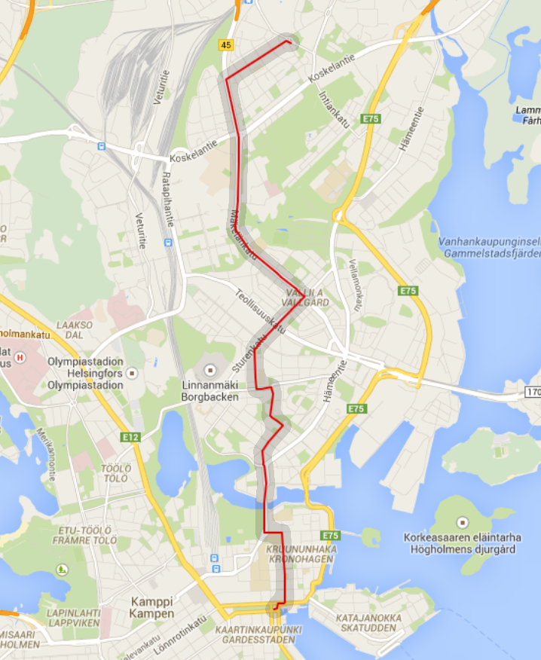
Probability density function
Honkela (2001)

Slide 20
Modeling
States
Stops
Routes
Neutral
Observations
GPS coordinates
Time dependent

Slide 21
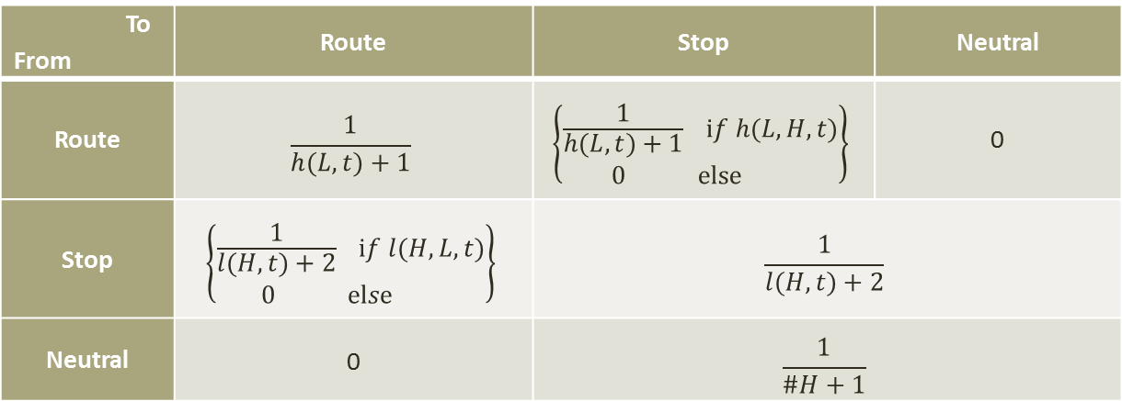
State transition probability
To From | Route | Stop | Neutral
Route | $$\frac{1}{h(L, t)+1}$$ | $$\left\{{\frac{1}{h(L, t)+1} if h(L,H,t) \atop 0 else }\right\}$$ | 0
Stop | $$\left\{{\frac{1}{l(H, t)+2} if l(H,L,t) \atop 0 else }\right\}$$ | $$\frac{1}{l(H, t)+2}$$
Neutral | 0 | $$\frac{1}{\#H+1}$$

Slide 22
Implementation
Static Route Data: GTFS
Onebusaway

Slide 23
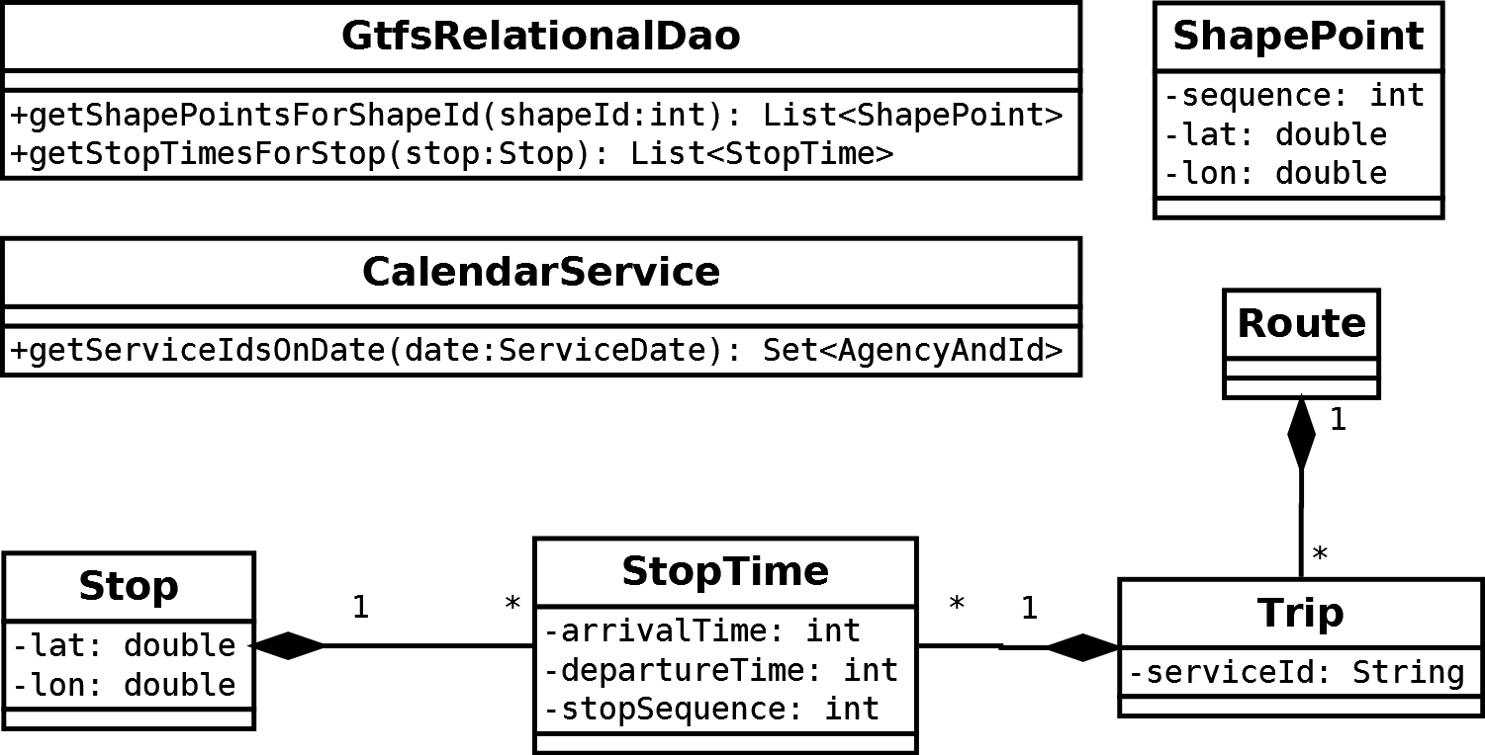

Slide 24
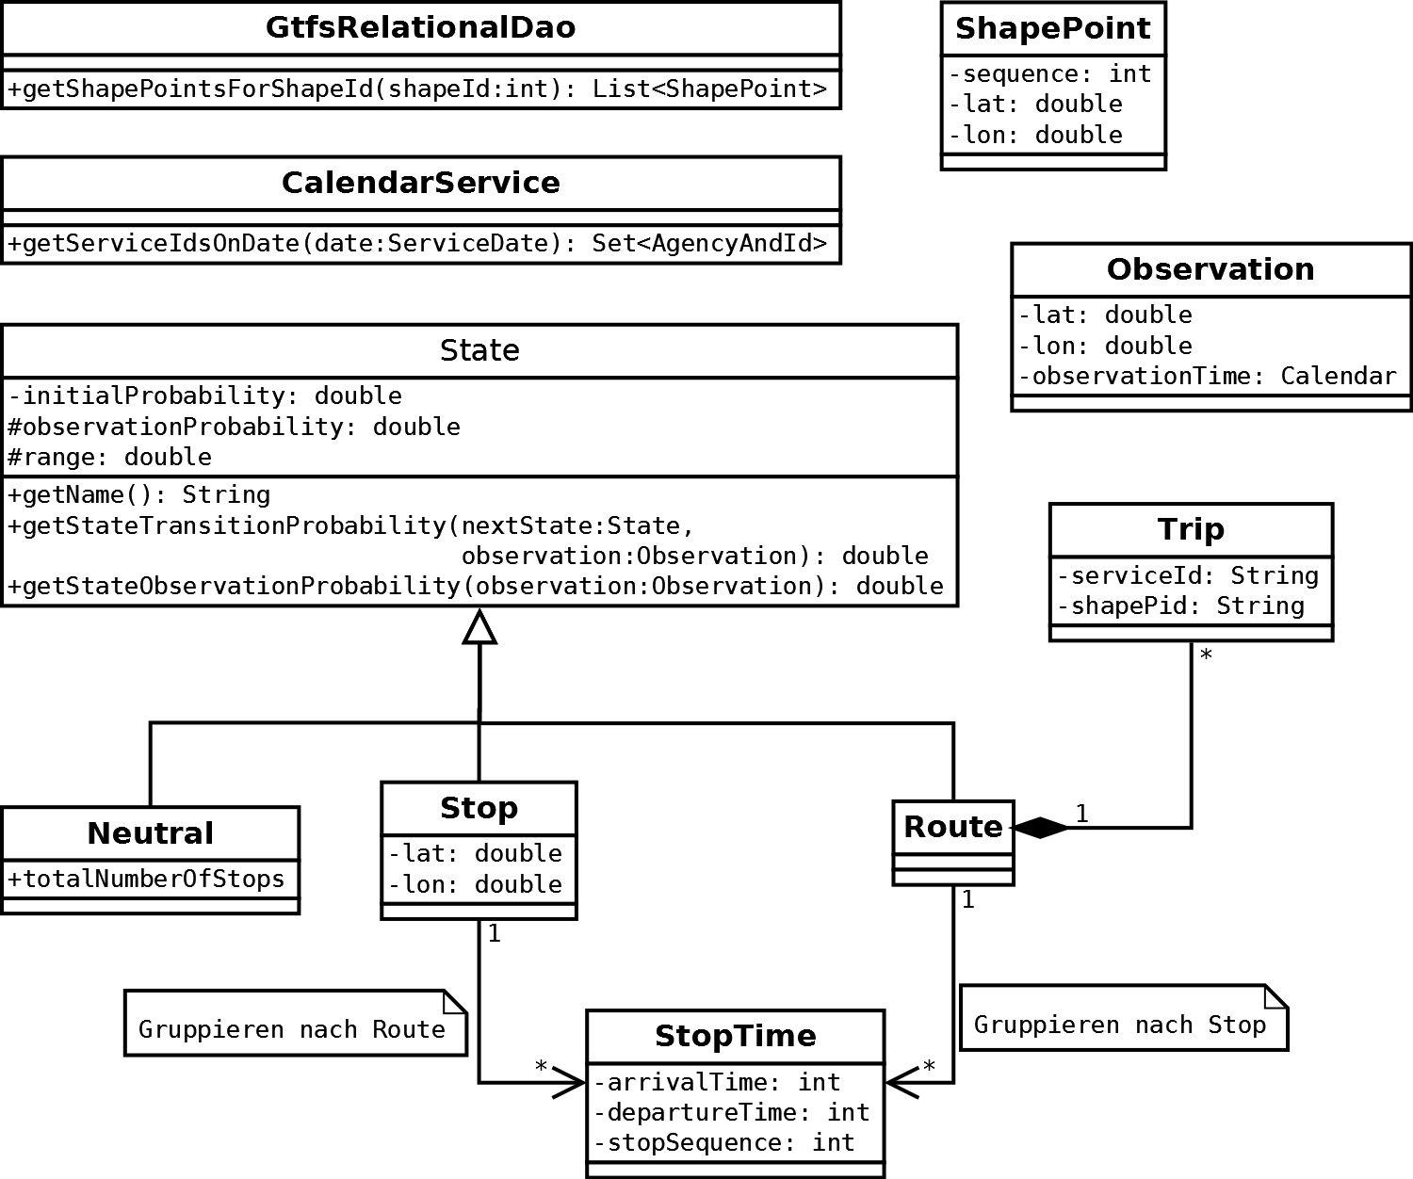

Slide 25
Evaluation
Trip Id | Route | Number of Observations
8 | 1070T | 137
11 | 1073 | 250
16 | 1004 | 138
17 | 1024 | 472
21 | 2315 | 333
23 | 4741 | 472
26 | 5530 | 281
36 | 1070T | 310
50 | 2150A | 263
51 | 2270 | 89
52 | 2550 | 247

Slide 26
# | Time | State
1 | 07:51:43 | Neutral
2 | 07:51:49 | Stop 1381121_Malmin tori
5 | 07:52:06 | Route 1077A_77A
7 | 07:52:17 | Stop 1382126_Malmin asema tulo
14 | 07:52:57 | Neutral
15 | 07:53:03 | Stop 1381101_Malmin asema(term.)
18 | 07:53:19 | Route 4519_519
21 | 07:53:35 | Stop 1382123_Ala-Malmi
22 | 07:53:41 | Route 2554_554
23 | 07:53:46 | Stop 1382124_Ala-Malmi
30 | 07:54:23 | Route 2554_554
36 | 07:54:56 | Stop 1382116_Riihenkulma
43 | 07:55:35 | Route 2554_554
50 | 07:56:15 | Route 2554_554
1 | 07:56:20 | Neutral
2 | 07:56:25 | Stop 1382128_Latokartanontie
3 | 07:56:31 | Stop 1382128_Latokartanontie

Slide 27
The problems
Higher propability for stops
Prioristation of shorter routes
Very low overall probability

Slide 28
Transition probabilites
To From | Route | Stop | Neutral
Route | 1 if same route 0 else | 1 if stops 0 else | 0
Stop | 1 if stops 0 else | 1 if same stop 0 else | 1
Neutral | 0 | 1 | 0,9

Slide 29
Observation probabilities
Neutral | Haltestelle | Linie
0.1 | 1.01 | 1

Slide 30
Results
21 trips tested
9 correct
6 partially
5 wrong

Slide 31
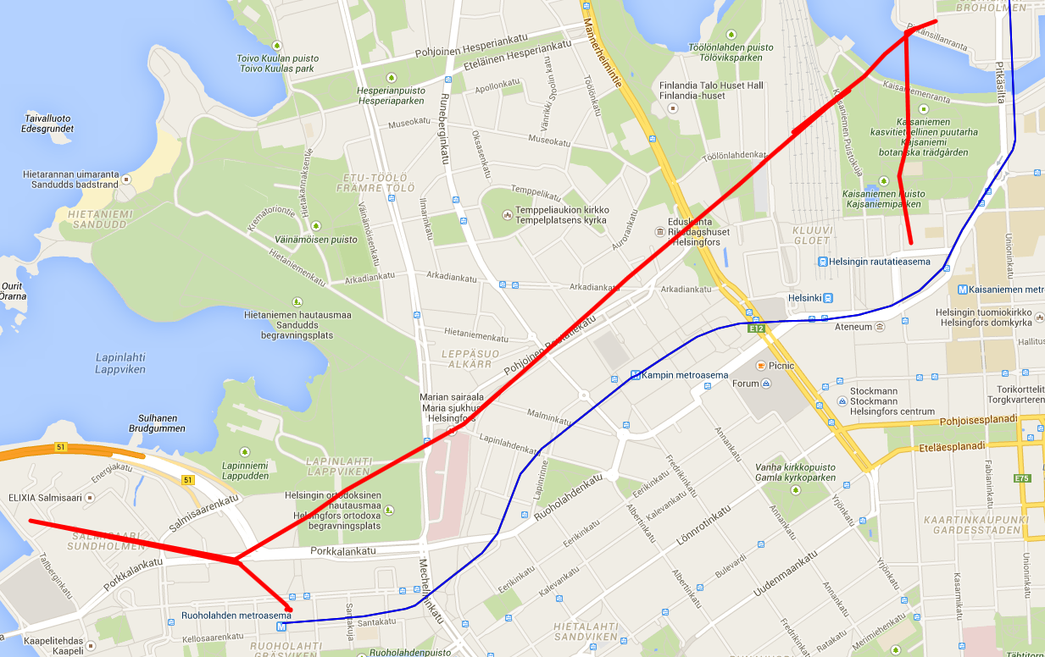

Slide 32
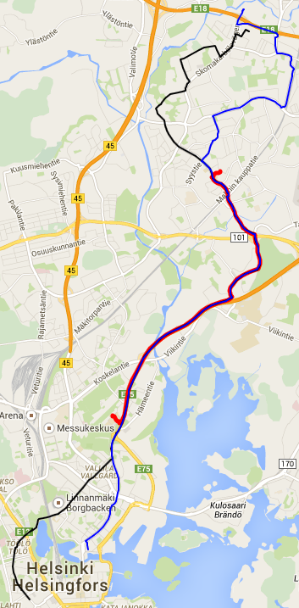

Slide 33
Conclusion
HMM can be used for SLD
Abused model
Not better than Live+Gov…
…but more potential

Slide 34
Future Works
Use Trips as states
State transition probabilities relative to time
Test in other cities
Test with further transportation means
Integration in other systems

Slide 35
Sources
L. R. Rabiner, "A tutorial on hidden Markov models and selected applications in speech recognition," Proceedings of the IEEE, vol. 77, no. 2, pp. 257-286, 2 1989.
R. C. Shah, C.-y. Wan, H. Lu und L. Nachman, „Classifying the Mode of Transportation on Mobile Phones using GIS Information,“ in Proceedings of the 2014 ACM International Joint Conference on Pervasive and Ubiquitous Computing, Seattle, Washington, 2014.
L. Stenneth, O. Wolfson, P. S. Yu und B. Xu, „Transportation Mode Detection using Mobile Phones and GIS Information,“ in Proceedings of the 19th ACM SIGSPATIAL International Conference on Advances in Geographic Information Systems, Chicago, Illinois, 2011.
P. Zhou, Y. Zheng und M. Li, „How Long to Wait? Predicting Bus Arrival Time With Mobile Phone Based Participatory Sensing,“ IEEE Transactions on Mobile Computing, Bd. 13, Nr. 6, pp. 1228-1241, 2014.
A. Honkela, Nonlinear Switching State-Space Models, 2001..

Slide 36
Sources
Live+Gov: http://liveandgov.eu
Mattersoft: http://www.mattersoft.fi/
HSL: https://www.hsl.fi/

Slide 37
Questions?

